Slide 1
CS 551
Spring 2025

Slide 2
Slices
Let’s write a function that takes in a string and returns the first word of that string
If it doesn’t find a space anywhere in the string, it returns entire string
We can add some efficiency by just using some kind of reference to the string instead of moving it.
A move implies some sort of memcpy()
fn first_word(s: &String) -> ?
What should we return?
We haven’t talked about getting part of a string
Maybe we should return the index of the end of that word?

Slide 4
Will it compile?

Slide 5
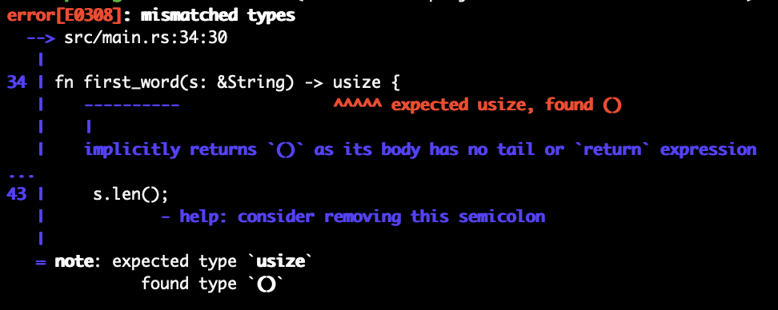

Slide 8


Slide 10
We clear() out s, which changes its value to “”

Slide 11
first_word_index is now meaningless

Slide 12
We could modify the string in a lot of ways that would make first_word_index meaningless!

Slide 13
String Slices

Slide 14
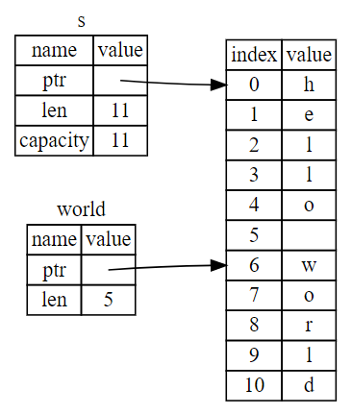
String Slices
Use the range operator [start..end]
Non inclusive of end!
[..] → entire String
[..end] → index 0 through end – 1
[5..] → index 5 through the entire string
[5..=6] → indexes 5 through 6 (inclusive)

Slide 15
String Slices
Strings in rust are UTF-8 encoded, so, technically speaking, you can only slice them up across valid UTF-8 boundaries
Use the range operator [start..end]
Non inclusive of end!
[..] → entire String
[..end] → index 0 through end – 1
[5..] → index 5 through the entire string
[5..=6] → indexes 5 through 6 (inclusive)

Slide 18
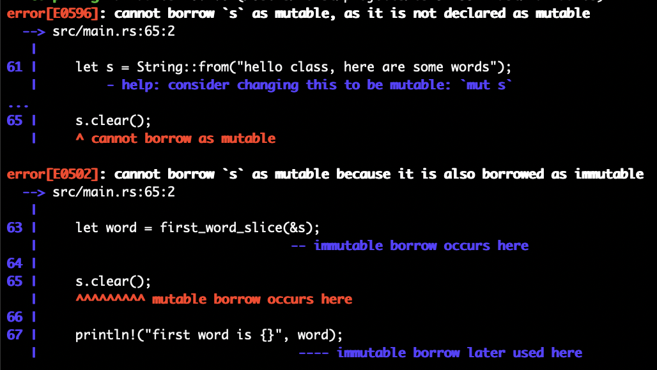

Slide 19
Can eliminate the first one by making s mutable
Second error does not go away though…
Why?!?

Slide 20
Reference rules:
At any given time, you can have one mutable reference or any number of immutable references
References must always be valid

Slide 22
s is a mutable reference to a String

Slide 23
first_word_slice() borrows an immutable reference to s

Slide 24
first_word_slice() returns an immutable reference into s

Slide 25
clear() requires a mutable reference, but we already have an immutable reference into s, so compiler stops us

Slide 26
We can also make things a bit cleaner…
Change our function signature to make things more flexible
Remember that &str and String are not the same
&str is a slice
We can easily borrow a slice from a String tho!
Parameterize on &str instead of &String

